Slide 1
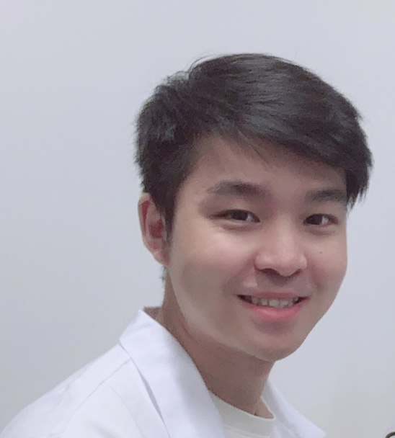
Qiang Li
TwoDIgits | Tech industry x and IOT & ML Ana
qiang.li@rwth-aachen.de | Mobile: 004915236281415
AREAS OF EXPERTISE
Computer vision
Machine Learning
NLP
Data modeling
Six sigma data analysis
Python, Java, SQL database
Agile methodologies
Internet of Things (Sensor technology)
Flash, PyQT, Web App development
PROFESSIONAL BACKGROUND
I am a graduate computer science student at RWTH-Aachen, wrote my master thesis under the supervision of Prof. Dr. Bastian Leibe and an IDEA Research Grant Student in Prof. Dr. Manfred Claassen Group, ETH Zürich. I got my B.S degree from the HFUT with Top academic performance and received four years national scholarships. My Bachelor was majoring in IoT and also founded the HFUT Robocup Lab. After my B.S studies, I worked as a computer vision working student in Siemens AG Aachen Gas Turbine research center while taking the Master Informatik study at RWTH Aachen. My research interests focus on object recognition, base detection and segmentation, model interpretability, multi-tasking, and multi-modality.
CERTIFICATIONS
MSc, Computer Studies focus on Machine Learning and Computer vision
Six sigma data analysis: Yellow belt
One publication on Top-tier conference ICLR’21-AI4PHWorkshop
INDUSTRIES
Additive Manufacturing
FinTech
Medical Healthcare
Robot
RELEVANT PROJECT EXPERIENCE
PayLuft - Computer Vision software Engineer Intern
15.02.2021 To 31.05.2021
Software Engineer
Developed biometric payment system
Finished three Flask ML payment apps from scratch: Ecommerce, P2P, retail store
Python, TensorFlow, Metapipeline, HTML, JavaScript, OpenCV, Palm Dataset
ETH Zürich- Master Thesis and Research Assistant
01.12.2019 To 31.08.2020
Masterand and Researcher
Designed CellNet and AttentationNet for Sezary syndrome detection
Developed CellNet software, including 10 interfaces, 25 buttons, 10+ user prompt functions, and integrating with 12 algorithms and 8 data sets. Achieved 2nd place on the Deecamp2020 medical track
Python, PyQt, YOLO, GhostNet, FasterRCNN
Siemens AG- Aachen Gas Turbine Research Center
01.12.2018 To 01.12.2019
Computer Vision Working Student
Data acquisition, handling, aggregating, and analytics for monitoring of additive manufacturing process
Responsible for Siemens Mindsphere cloud-based application Maintenance App and embedded image processing software development
C++, Nodejs, Scikit-learn, Pandas, Snakes, PCA
Notes:
Sprache: English
Fokus: Technisch
I haven’t received the Accenture email and Accenture mobile, so I am using my school email account. I will update it as soon as I received my Accenture email address.

